Slide 1

Concurrency Bugs
PASS
CS532: OS Foundations
Lab Assignment
email address: parth2@pdx.edu
partner’s email address:

Slide 2
Instructions: Make a copy of this document, move your copy to your submissions folder and fill the document with your responses. Use the space on each slide to show your responses, and add additional slides as needed.
When ready for grading: complete the lab assignment submission form and include a link to your filled document

Slide 3
1. When you wrote your helloT program, did you encounter (or create) any concurrency bugs? If so, then describe what type of concurrency bug(s) you encountered. Use the terminology from the reading/lecture, i.e., "Data Race", "Deadlock", "Order Violation", etc.
Answer: - When the helloT.c program was compiled and run, then, there is a “DATA RACE” condition in which the variable factorial is being accessed by many threads. This means a shared memory is being accessed (read/write) by multiple threads. The section where factorial is being calculated is also the critical section being accessed by multiple threads at the same time
On improving the helloT.c program, we created a new program helloT2.c where we had introduced a mutex lock which helped us protect the memory for multiple threads accessing it at the same time.

Slide 4
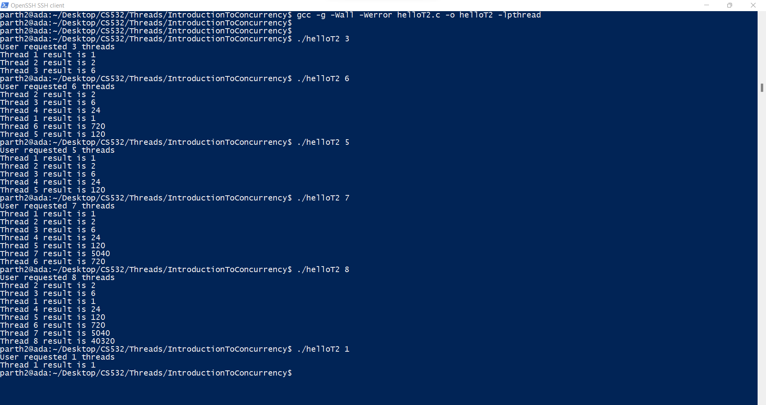
While Data Race is a fairly common condition occurring in concurrency, Order Violation is also present in the helloT.c and helloT2.c as well wherein some results are calculated earlier than their previous results.
For example:- In many cases, Thread2 calculates result earlier than Thread1 in the image below:-

Slide 5
2A. The original sum program (from the Threads lab assignment) had a concurrency bug. What type of Concurrency bug did it have?
Answer:- The original sum program has one bug and that was data race. This is because all the threads were trying to access the same memory location simultaneously leading to faulty read/write operations for the variable which in turn produced faulty results.

Slide 6
2B. You then created sum2.c. What type of Concurrency bug did sum2 have?
Answer: - After we corrected the data race for sum.c, we had placed a mutex lock for the critical section where the sum was being calculated.
But while the program seemed to have become free of the concurrency bug, there still exists the problem of excessive waiting. This is because while the Total is being calculated correctly, it is in the critical section guarded by a mutex lock. This means that while total is being updated by thread1, other threads will have to wait unnecessarily to update Total (which is a global variable itself).
Also, We can see that this also leads to order violation as well as some threads calculate results quickly than others leading to order violation as well.
“Excessive waiting” is a type of concurrency bug.

Slide 7
3. The original pingpong.c source code had a concurrency bug. What type of Concurrency bug did it have?
Answer: - pingpong.c has order violation and atomicity violation concurrency bugs with order violation being the dominant one.
This is evident from the fact that when pingpong is run, then PING appears correctly but due to order violation, the desired order of memory access is flipped during concurrent execution. Due to this, pingpong.c results in error after first PING isp printed.

Slide 8
4. Build and run the provided bug4.c program which is linked from the course plan document.
Answer: - When we compile and run the program as is given in the Course Plan, it encounters a situations where the program is stuck and was not providing any output.
The program hangs when run.

Slide 9
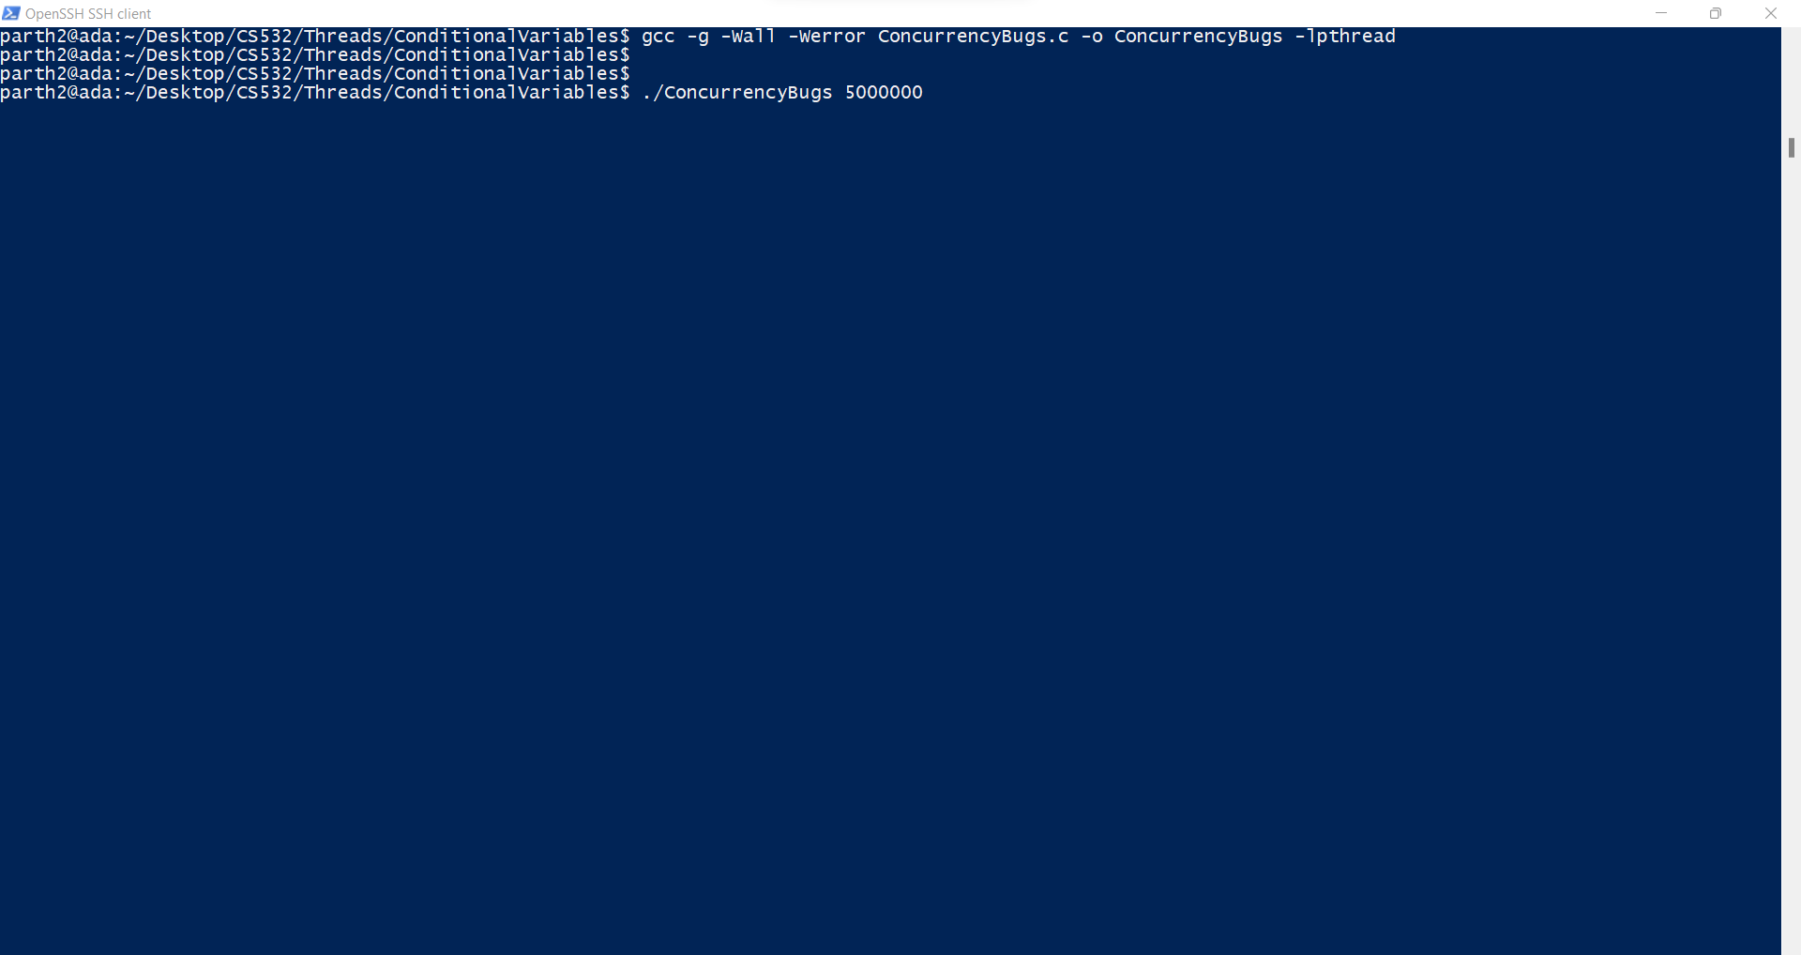

Slide 10
4A: What type of Concurrency bug does bug4 have?
Answer: - bug4 has Deadlock as the concurrency bug.
So when the two threads are created for two functions with mutex locks namely A and B in those two functions, then we can have a deadlock.
This is because when first thread is run on the function doWork1(), then it acquires Mutex Lock A.
By the time First Thread acquires Lock A, the second thread goes to the function doWork2() and it acquires Lock B.
While the Thread 1 moves forward, it will look for acquiring Lock B, but it is already acquired by the second thread. Hence, it will start waiting for the second thread to unlock the mutex lock B.
Similarly, Second thread starts waiting for Lock A to be unlocked by the first Thread. This results in a deadlock.

Slide 11
4B: Modify bug4.c to produce a new version, bug4_2.c that runs correctly. Test it thoroughly to convince yourself that your new version is functioning correctly. Upload bug4_2.c to your submission folder and provide a link to it here: https://drive.google.com/file/d/1i4RzBMSRAlkuGbLcGpLAEv2ECK_bPjBj/view?usp=sharing
To remove the deadlock mentioned in the previous slide, I have put mutex Locks A and B in such a way that when one is being executed, then the other must not request it. This means that when A is being executed first for the first Thread, Then second Thread should also request for A first and then B. This results in us avoiding the deadlock condition.
The next slides contain the output screens for various inputs that I have tested my code against followed by the actual code itself which can also be found in the link mentioned above.
Code looks good. I like the way you nested the locking.

Slide 12
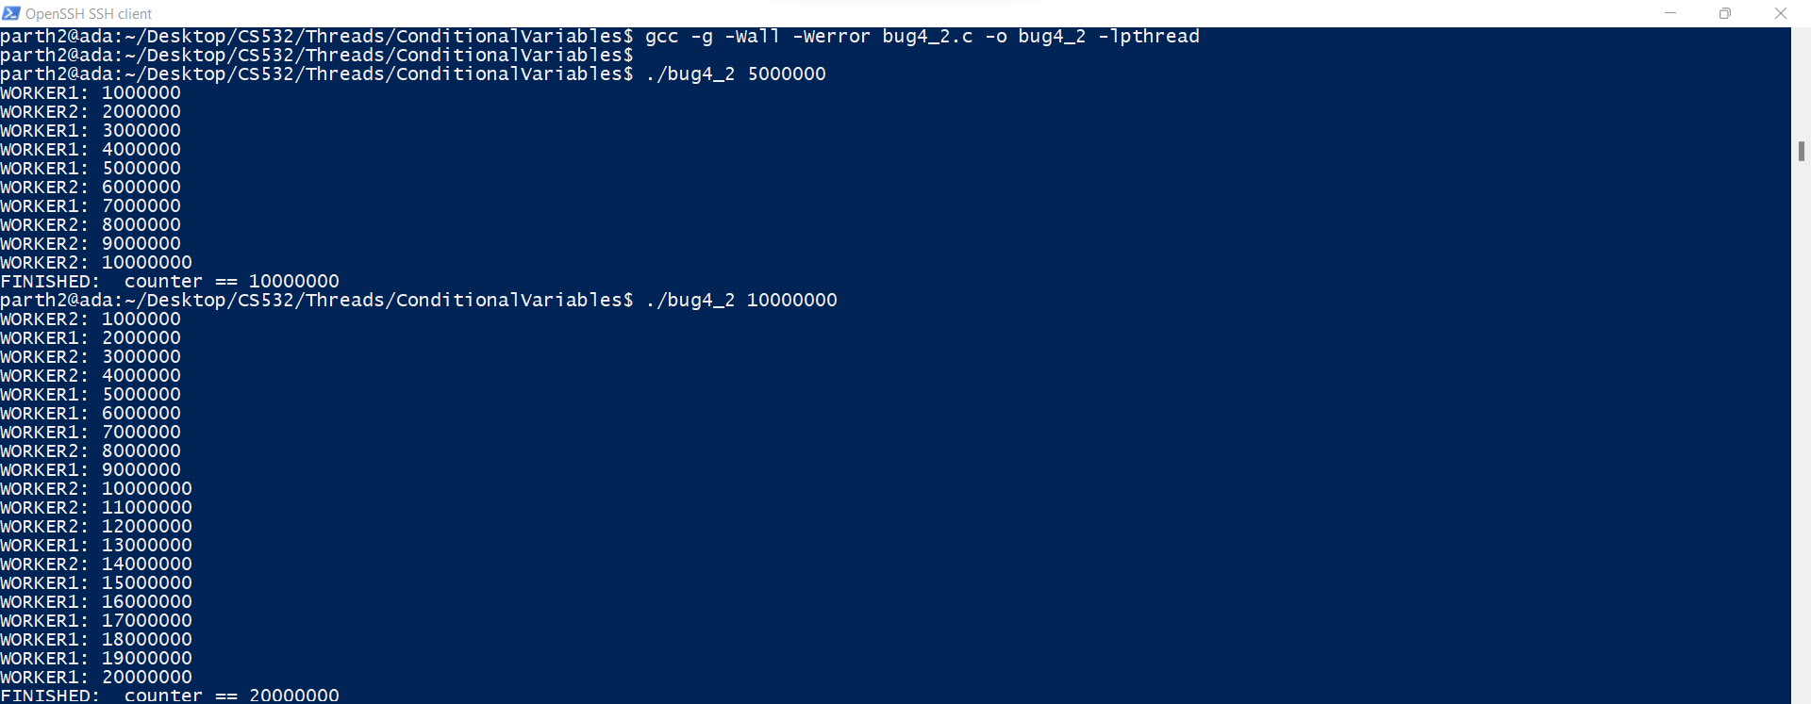

Slide 13
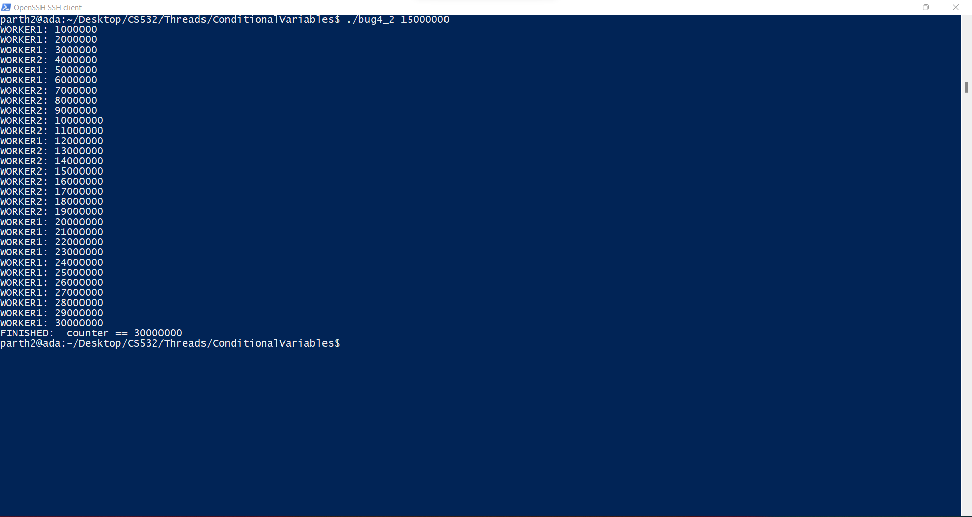

Slide 15
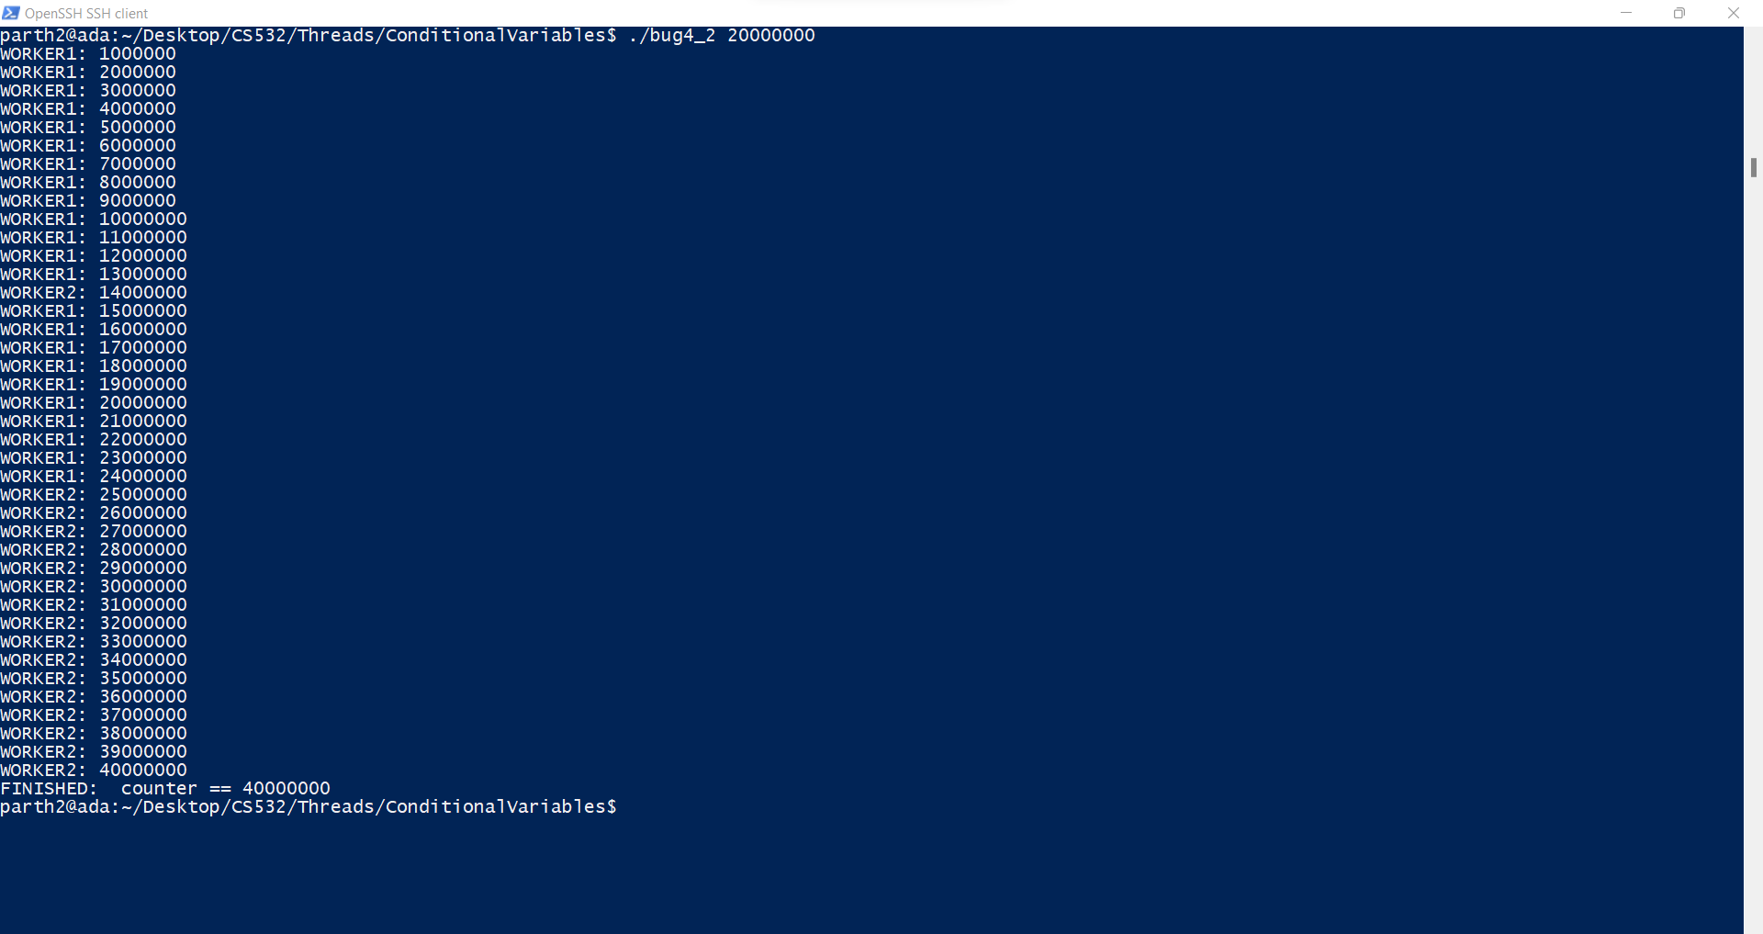

Slide 16
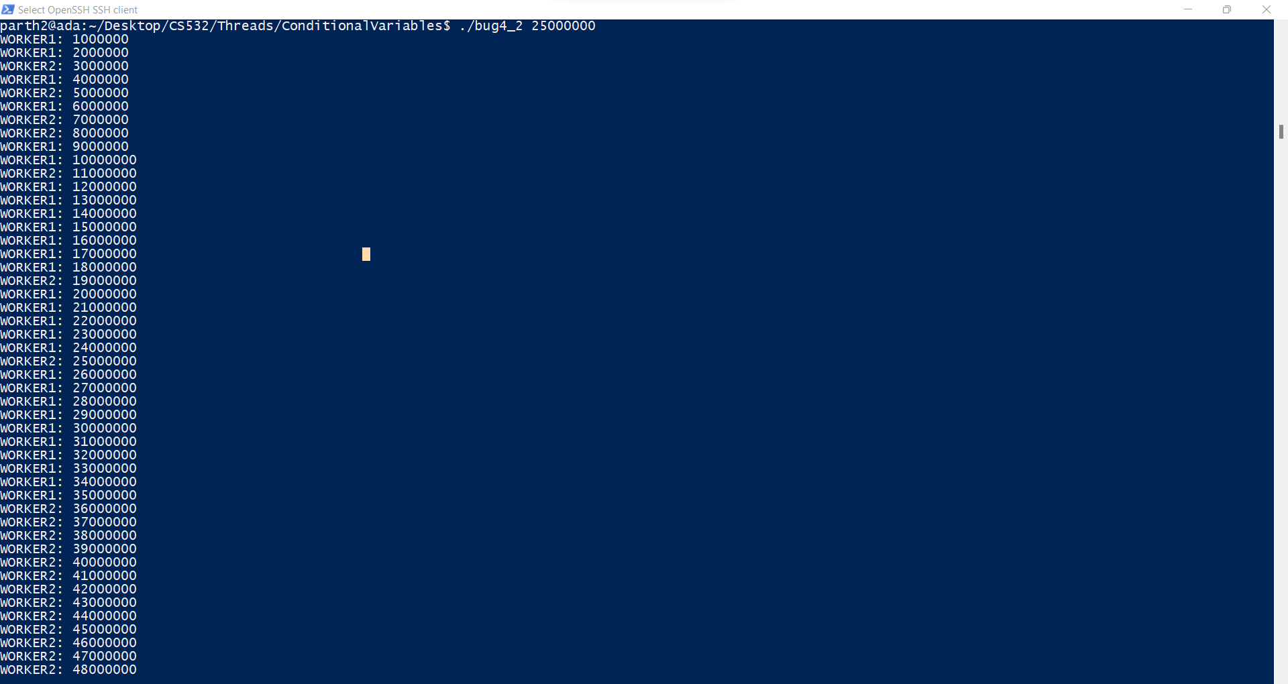

Slide 17
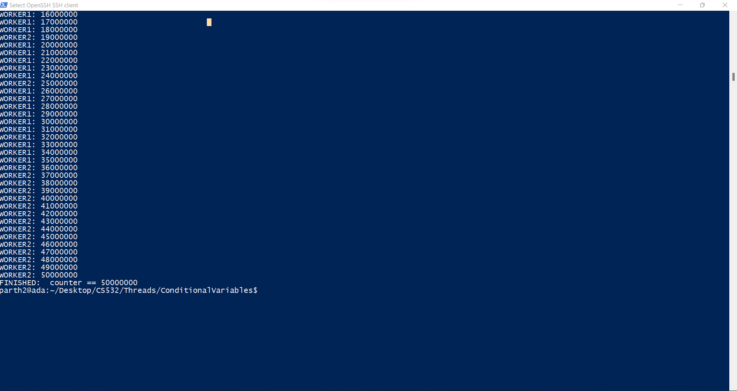

Slide 18
#include <stdio.h>
#include <stdlib.h>
#include <pthread.h>
#include <unistd.h>
#define SLEEPTIME 5
volatile unsigned long counter = 0;
unsigned long numloops;
pthread_mutex_t mutexA = PTHREAD_MUTEX_INITIALIZER;
pthread_mutex_t mutexB = PTHREAD_MUTEX_INITIALIZER;
void *dowork1(void *param)
{
for (int i = 0; i < numloops; i++) {
pthread_mutex_lock(&mutexA);
pthread_mutex_lock(&mutexB);
counter++;
if ((counter % 1000000) == 0) {
printf("WORKER1: %ld\n", counter);
}
pthread_mutex_unlock(&mutexB);
pthread_mutex_unlock(&mutexA);
}
return NULL;
}

Slide 19
void *dowork2(void *param)
{
for (int i = 0; i < numloops; i++) {
pthread_mutex_lock(&mutexA);
pthread_mutex_lock(&mutexB);
counter++;
if ((counter % 1000000) == 0) {
printf("WORKER2: %ld\n", counter);
}
pthread_mutex_unlock(&mutexB);
pthread_mutex_unlock(&mutexA);
}
return NULL;
}

Slide 20
int main(int argc, char **argv) {
if (argc != 2) {
fprintf(stderr, "USAGE: %s <size>\n", argv[0]);
exit(-1);
}
numloops = atol( argv[1] );
pthread_t w1, w2;
pthread_create(&w1, NULL, dowork1, NULL);
pthread_create(&w2, NULL, dowork2, NULL);
pthread_join(w1, NULL);
pthread_join(w2, NULL);
printf("FINISHED: counter == %ld\n", counter);
return 0;
}

